Slide 1

Open Source Brain and NeuroML
Enabling collaborative model development in
computational neuroscience
Open Source Brain workshop 2019
Padraig Gleeson
p.gleeson@ucl.ac.uk
University College London
http://www.opensourcebrain.org
Notes:
8/17/17
1
1

Slide 2
Overview
NeuroML
The Open Source Brain Initiative
Plans for OSB v2.0
http://www.opensourcebrain.org
Notes:
8/17/17
2
2
2

Slide 3
NeuroML
Standardised XML language for computational neuroscience
Original targets NEURON & GENESIS
Version 1.x allowed specification of:
Detailed neuronal morphologies
Ion channels
Synapses
3D network structure & connectivity
30+ simulators/applications/databases/libraries support NeuroML
Gleeson et al. PLoS Comp Biol, 2010
http://www.opensourcebrain.org
Notes:
8/17/17
3
3

Slide 4
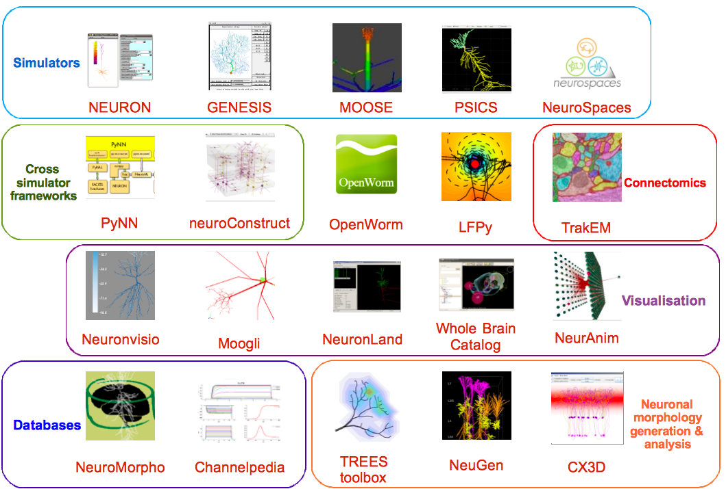
http://www.opensourcebrain.org
Notes:
8/17/17
4
4

Slide 5
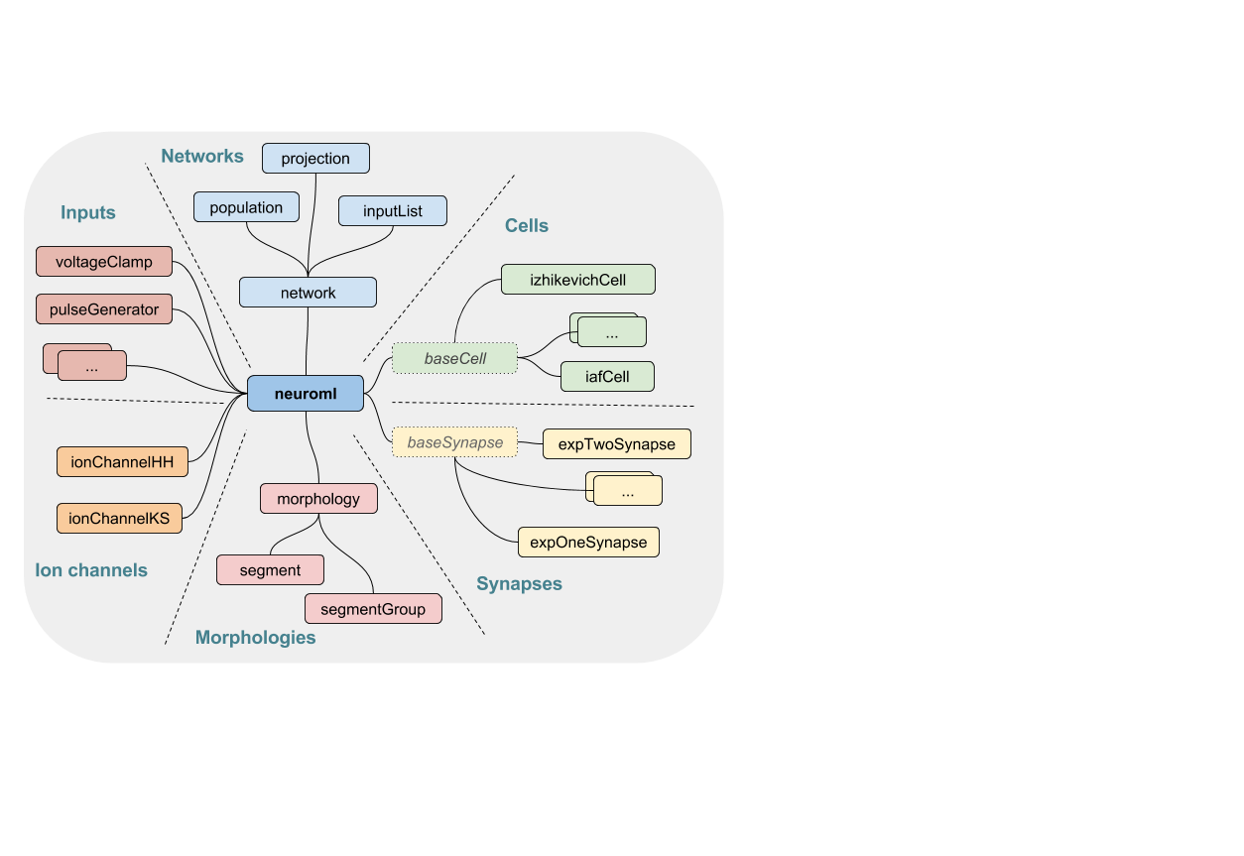
http://www.opensourcebrain.org
Notes:
8/17/17
5
5

Slide 6
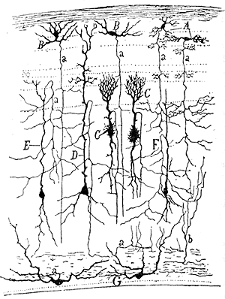
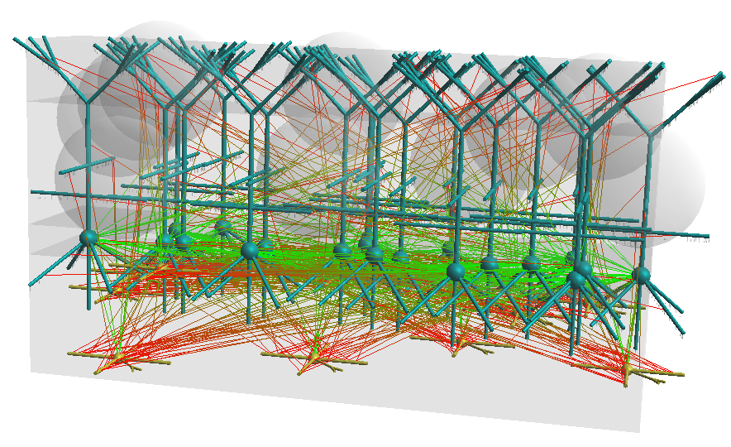
http://www.opensourcebrain.org
Notes:
8/17/17
6
6

Slide 7
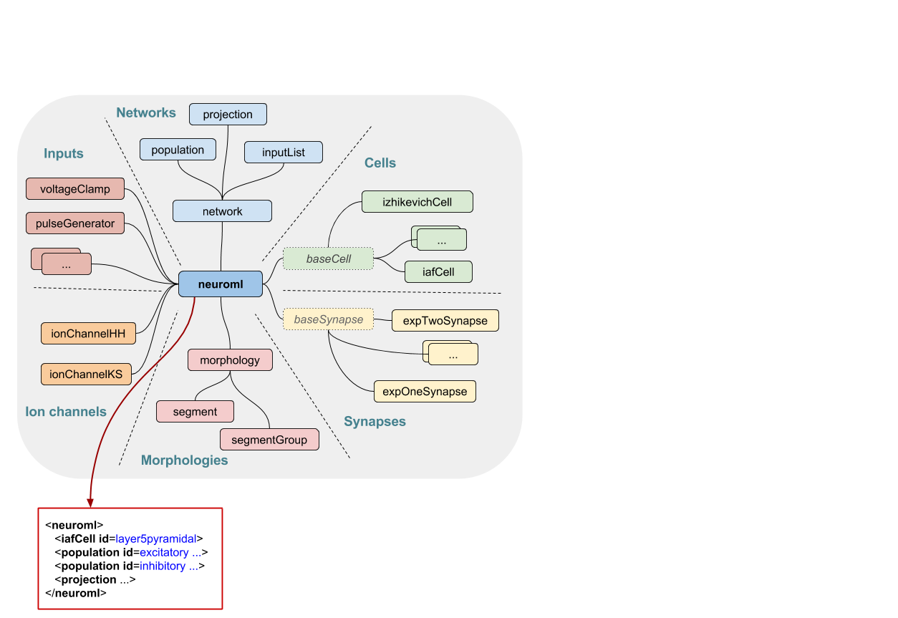
http://www.opensourcebrain.org
Notes:
8/17/17
7
7

Slide 8
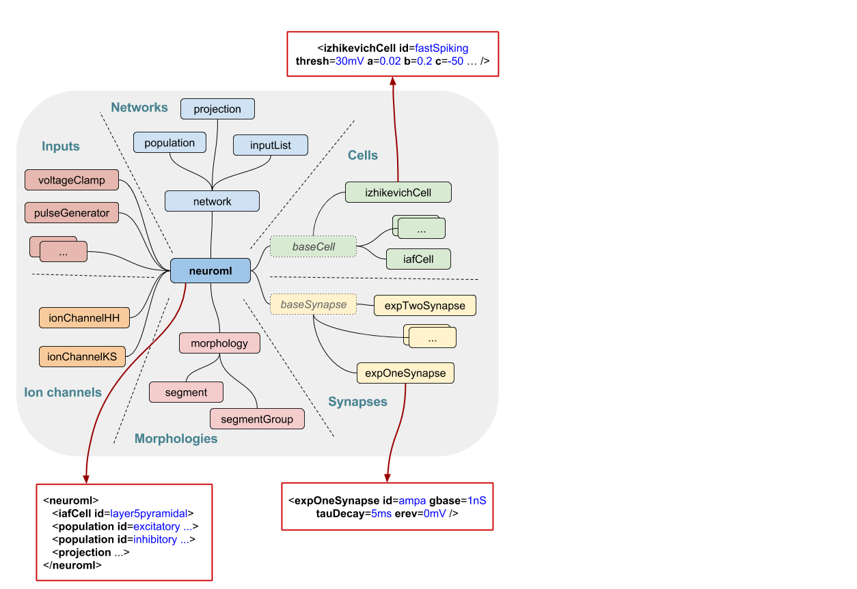
http://www.opensourcebrain.org
Notes:
8/17/17
8
8

Slide 9
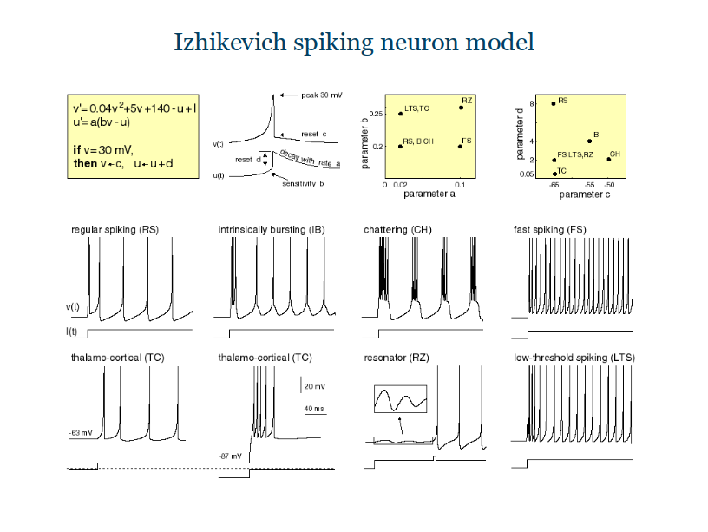

Slide 10
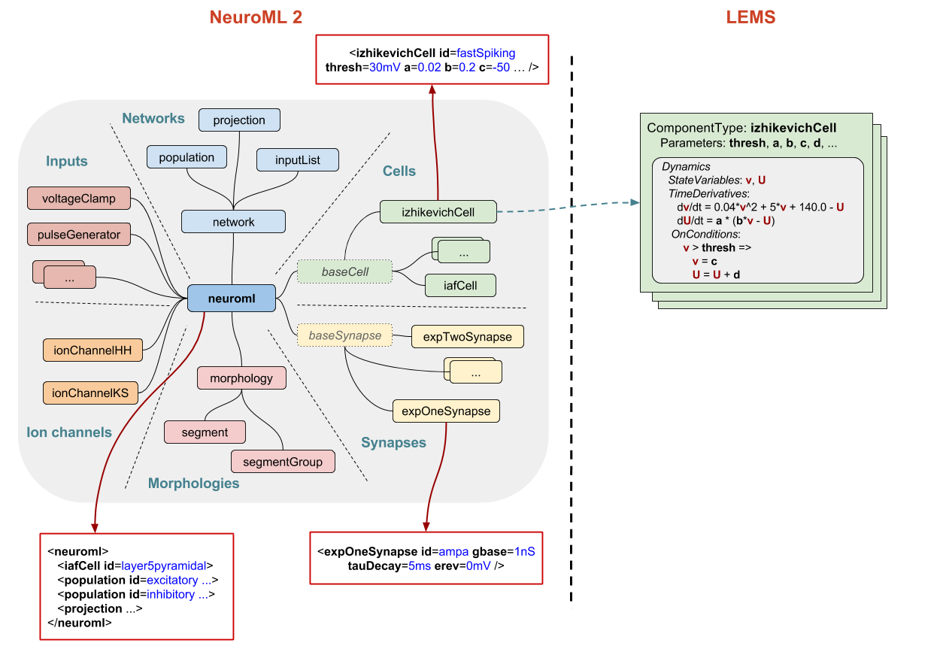
Low Entropy Model Specification language
http://www.opensourcebrain.org
Notes:
8/17/17
10
10

Slide 11
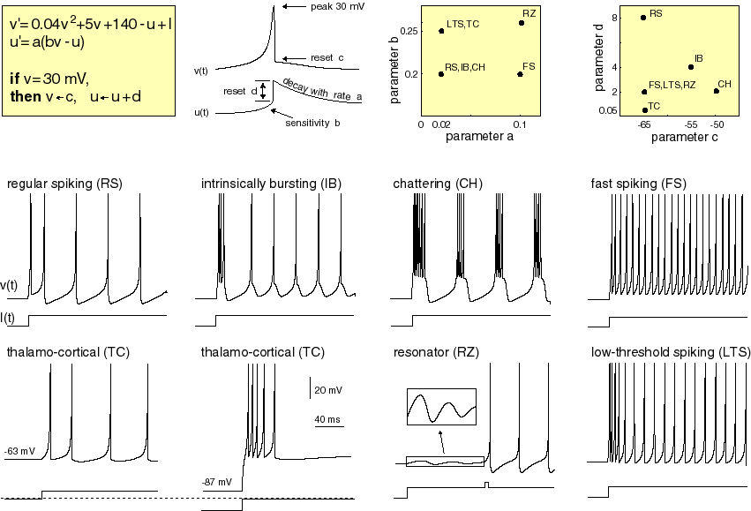
http://www.opensourcebrain.org
Notes:
8/17/17
11
11

Slide 12
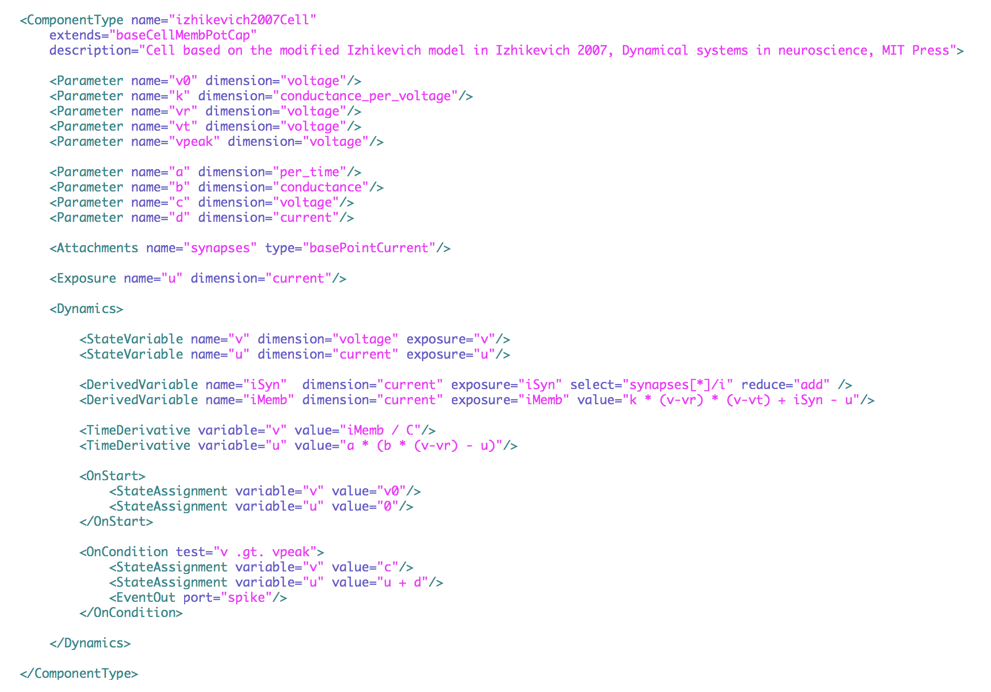

Slide 13
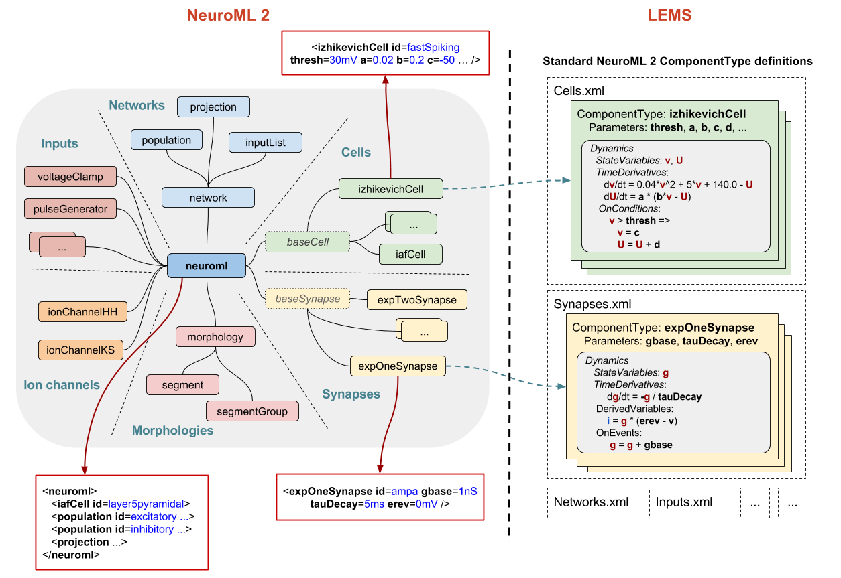
http://www.opensourcebrain.org
Notes:
8/17/17
13
13

Slide 14
Models
NeuroML
Simulators
jNeuroML
NeuroML
Python
libraries
Networks
NEURON
Detailed cells
NetPyNE
Abstract cells
MOOSE
XML
Synapses
PyNN
NEURON
Ion Channels
NEST
Brian
Visualisation
Automated
analysis

Slide 15
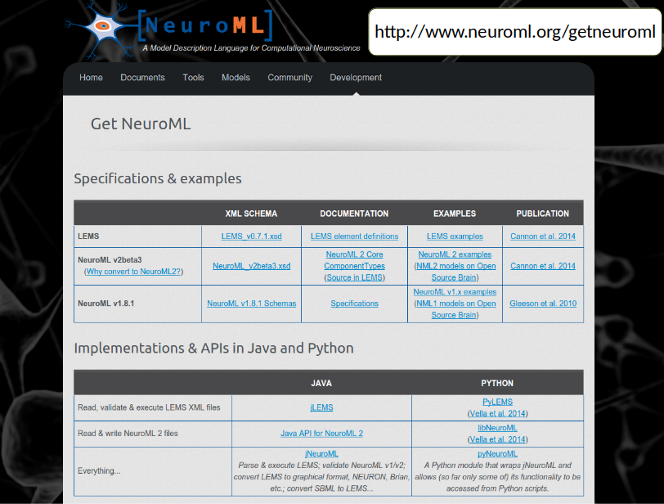

Slide 16
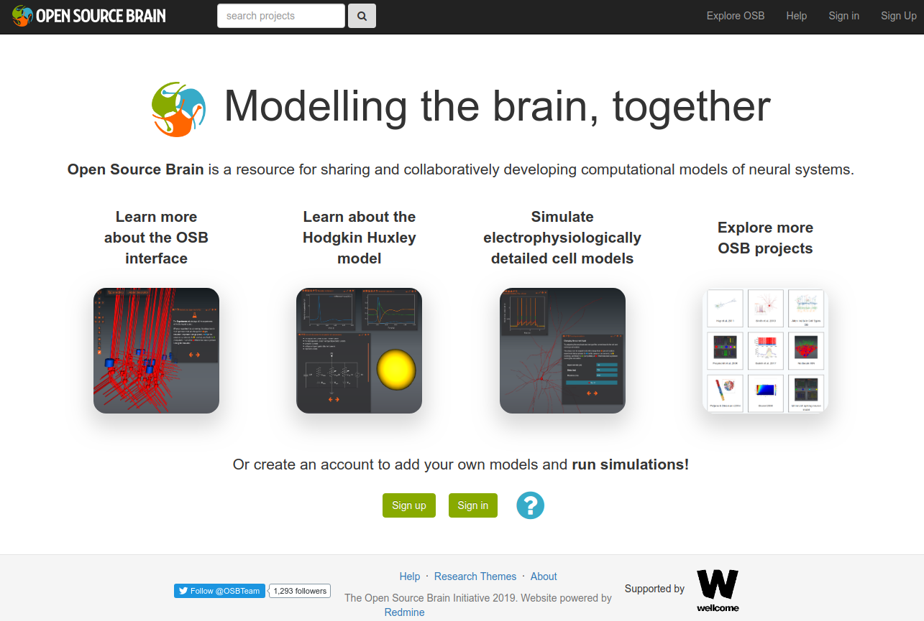
http://www.opensourcebrain.org
Notes:
8/17/17
16
16
16

Slide 17
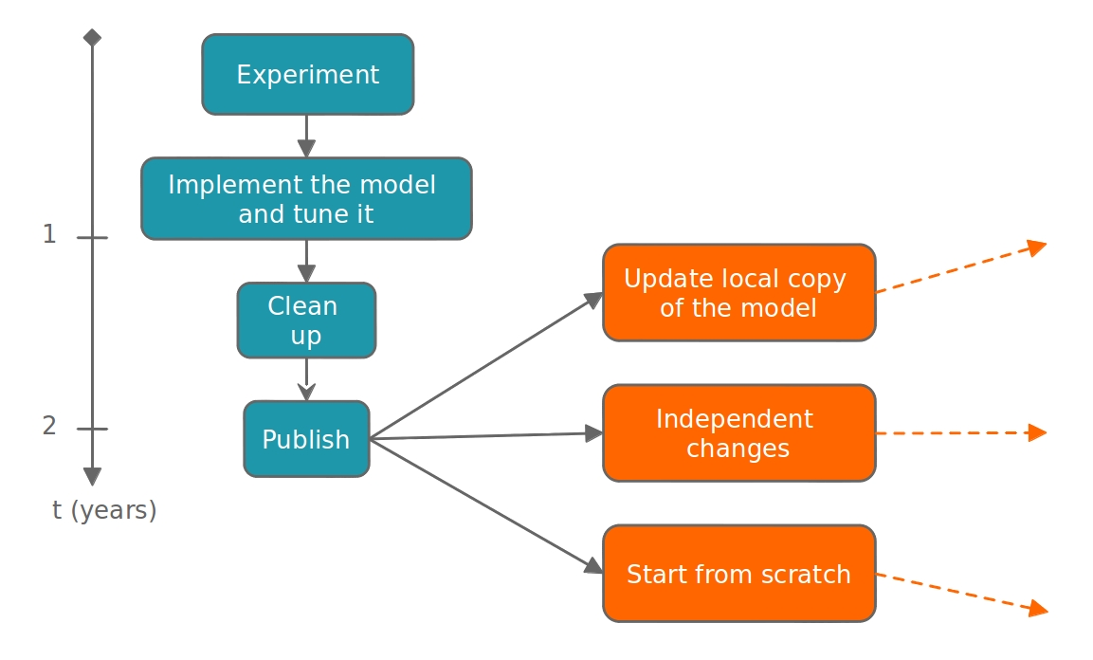
Traditional model development life-cycle
Notes:
8/17/17
17
17
17

Slide 18
Traditional model development life-cycle
http://www.opensourcebrain.org
Notes:
8/17/17
18
18
18

Slide 19
The Open Source Brain repository
Wellcome Trust funded project
Open source model development repository for computational neuroscience
Structured database of well tested neuron & network models in standardised formats
Allow anyone to comment on, extend, reuse models & run them across multiple simulators: a collaboration platform
Uses tools & best practices from Open Source software development
http://www.opensourcebrain.org
Notes:
8/17/17
19
19

Slide 20
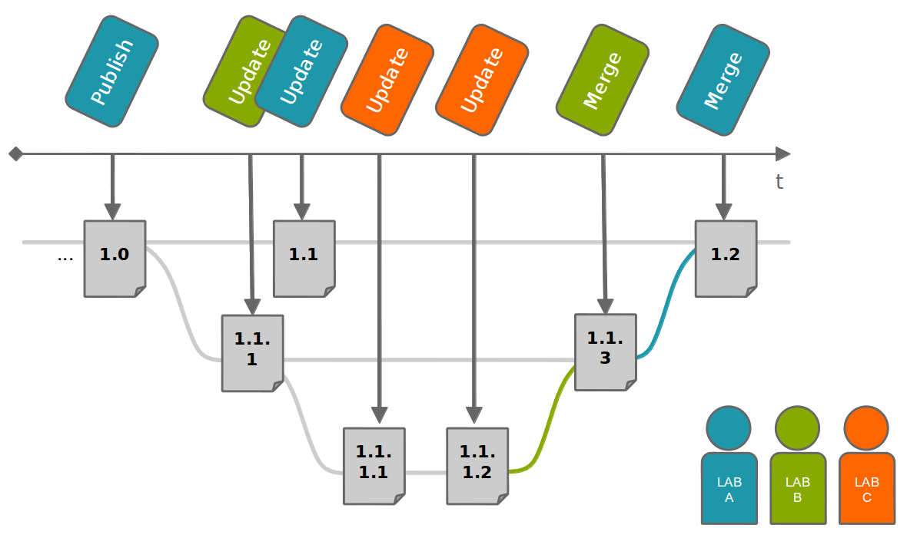
OSB development scenario
http://www.opensourcebrain.org
Notes:
8/17/17
20
20
20

Slide 21
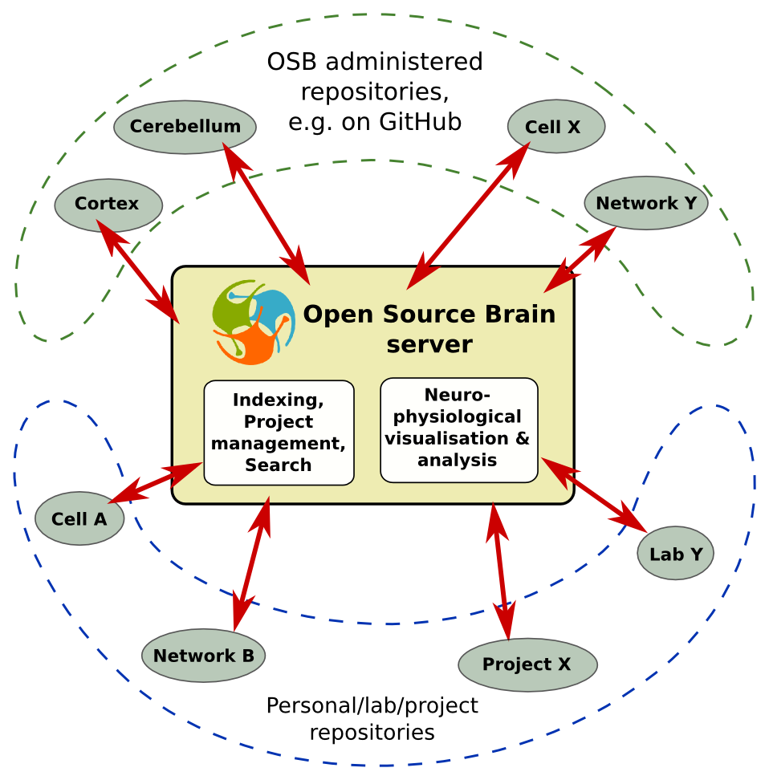

“Hub and Spoke” architecture
http://www.opensourcebrain.org
Notes:
8/17/17
21
21
21

Slide 22
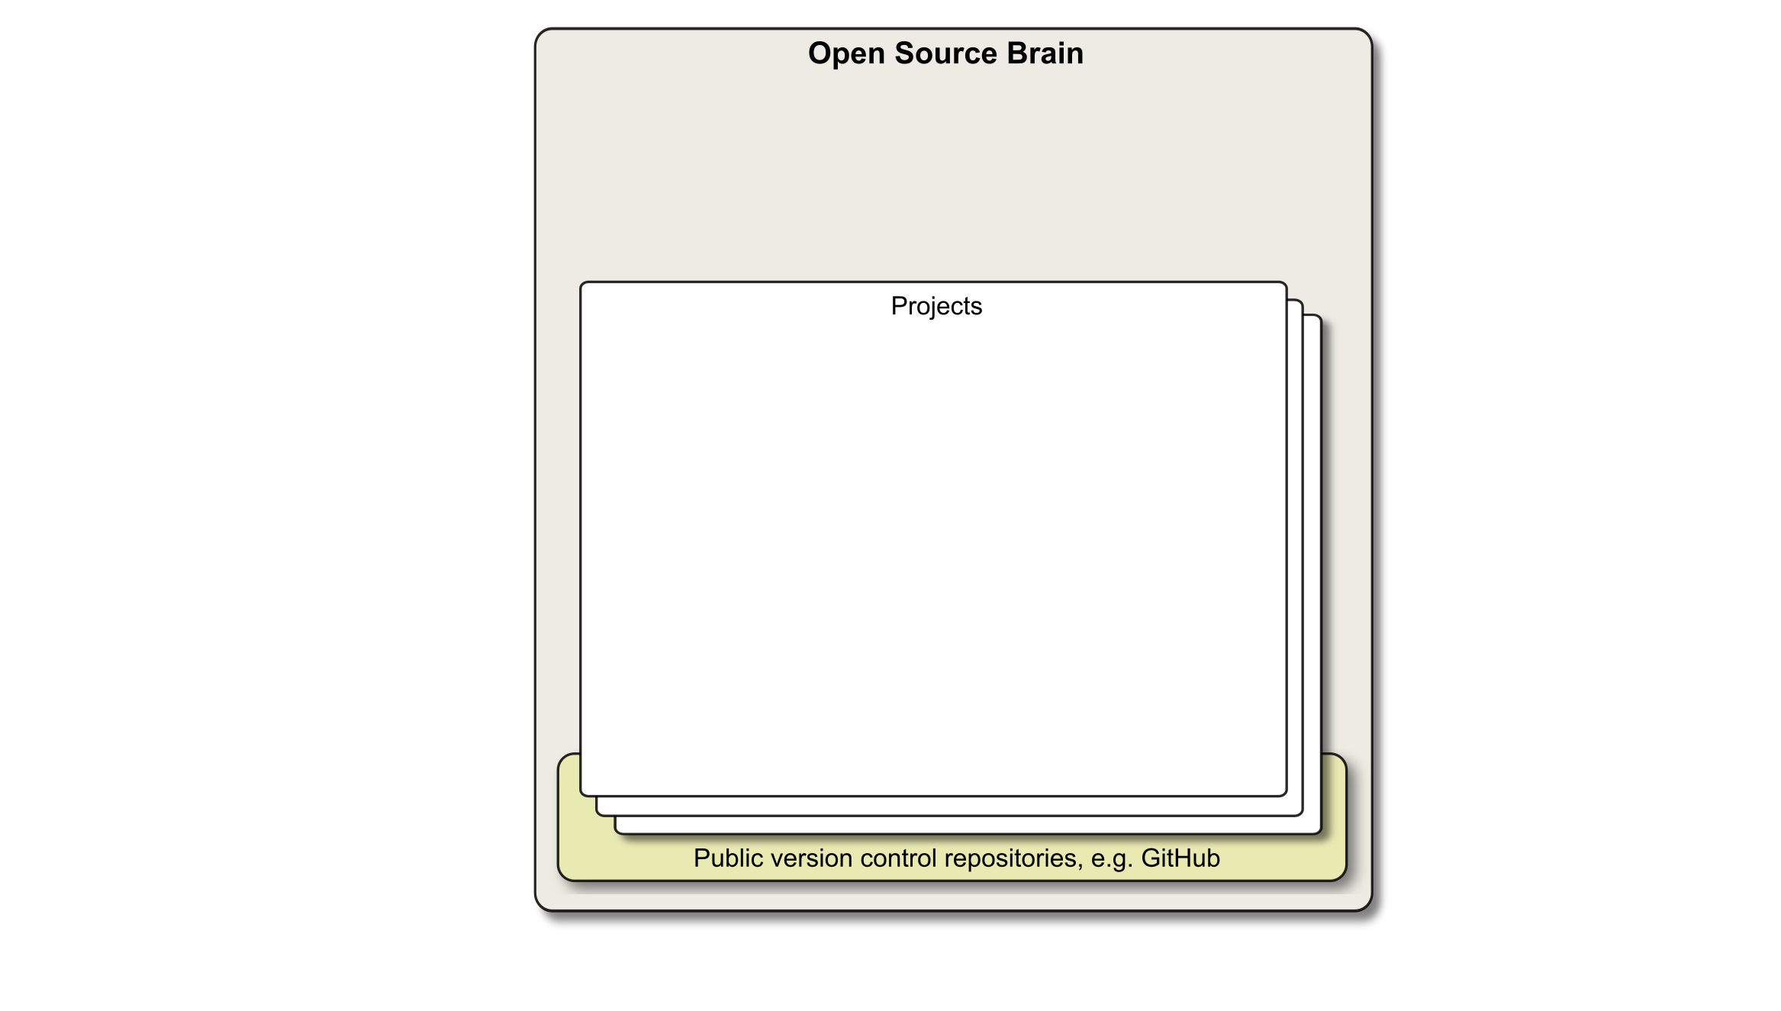
OSB features
Notes:
8/17/17
22
22

Slide 23
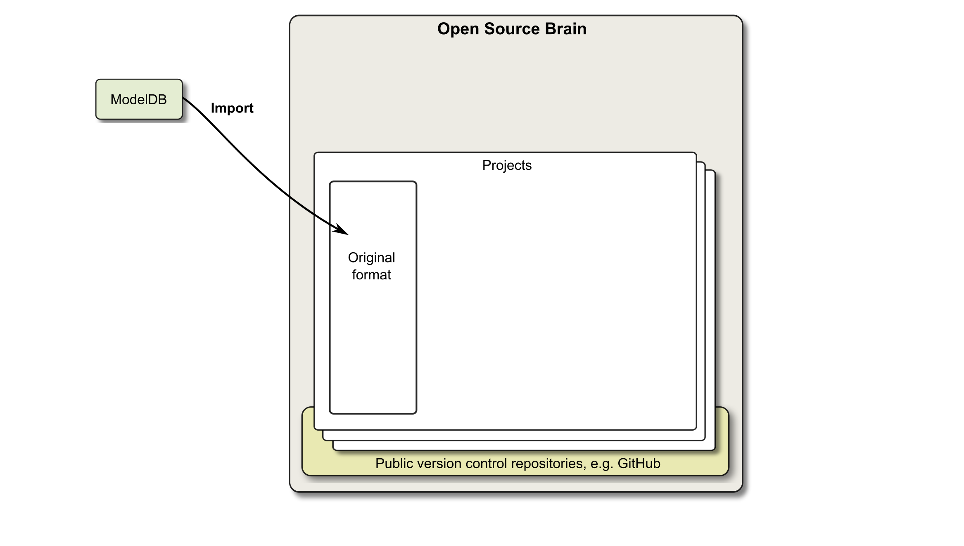
OSB features
Notes:
8/17/17
23
23

Slide 24
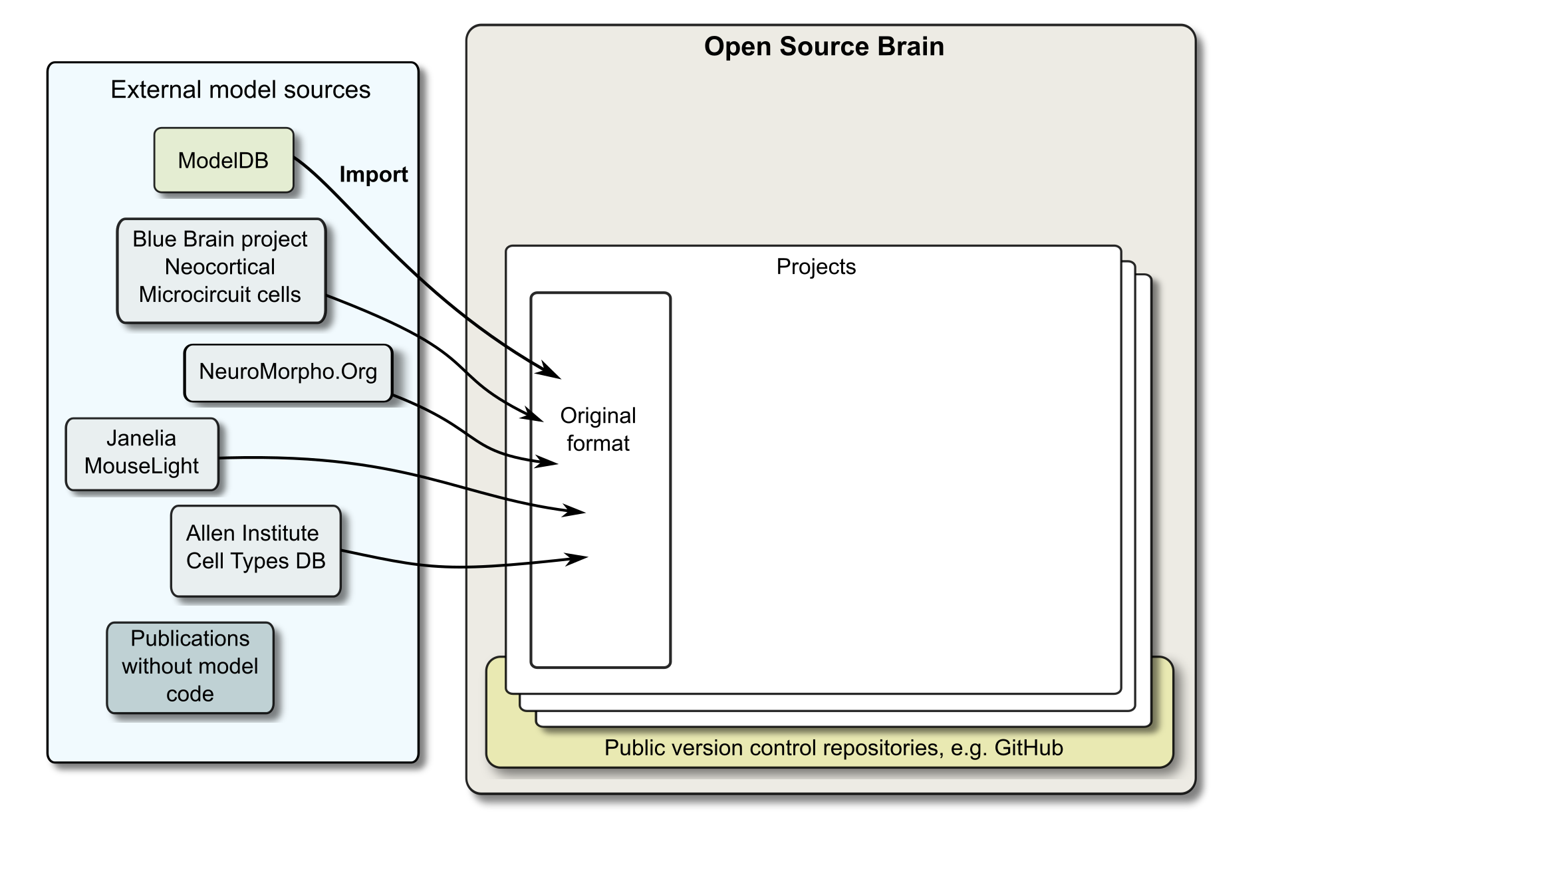
OSB features
Notes:
8/17/17
24
24

Slide 25
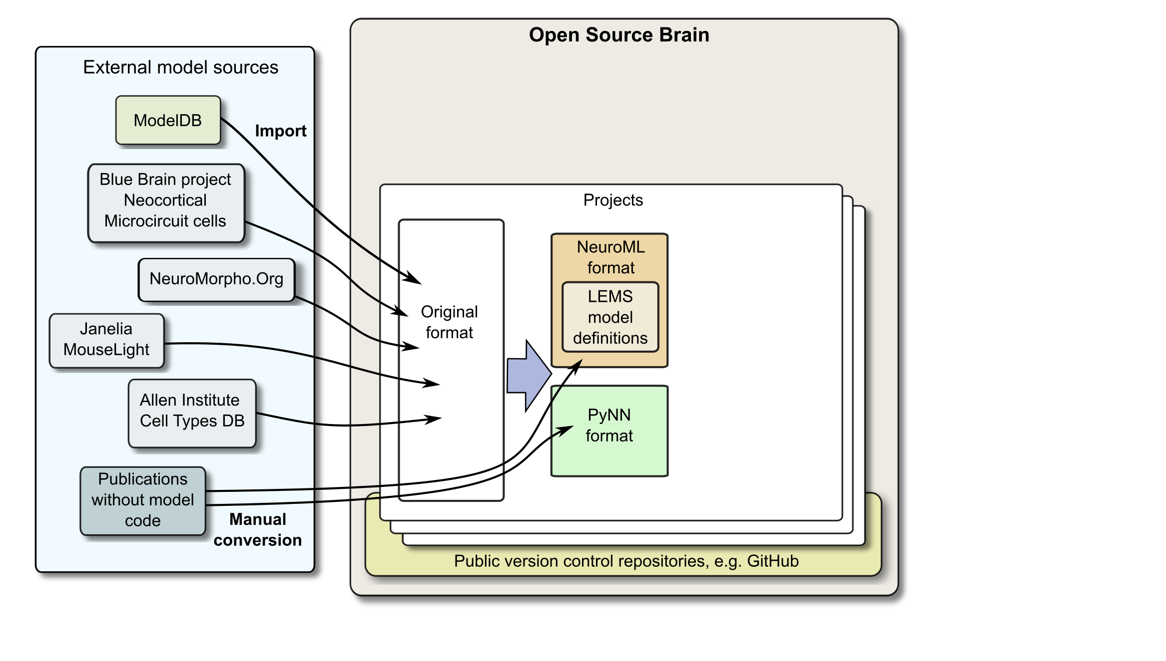
OSB features
Notes:
8/17/17
25
25

Slide 26
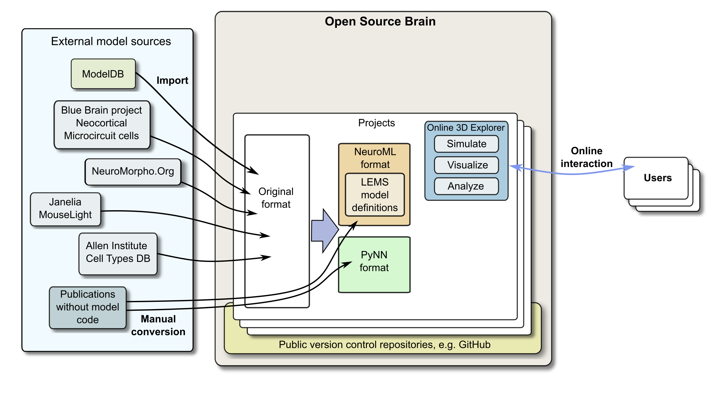
OSB features
Notes:
8/17/17
26
26

Slide 27

OSB features
Notes:
8/17/17
27
27

Slide 28
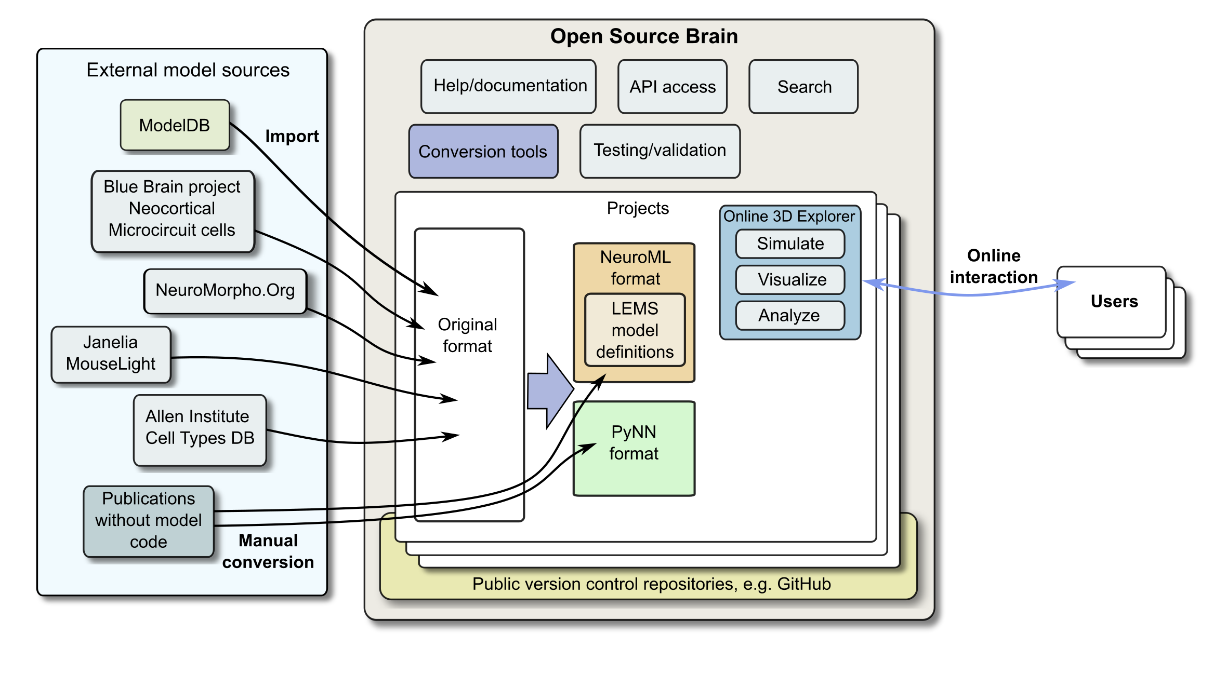
OSB features
Notes:
8/17/17
28
28

Slide 29
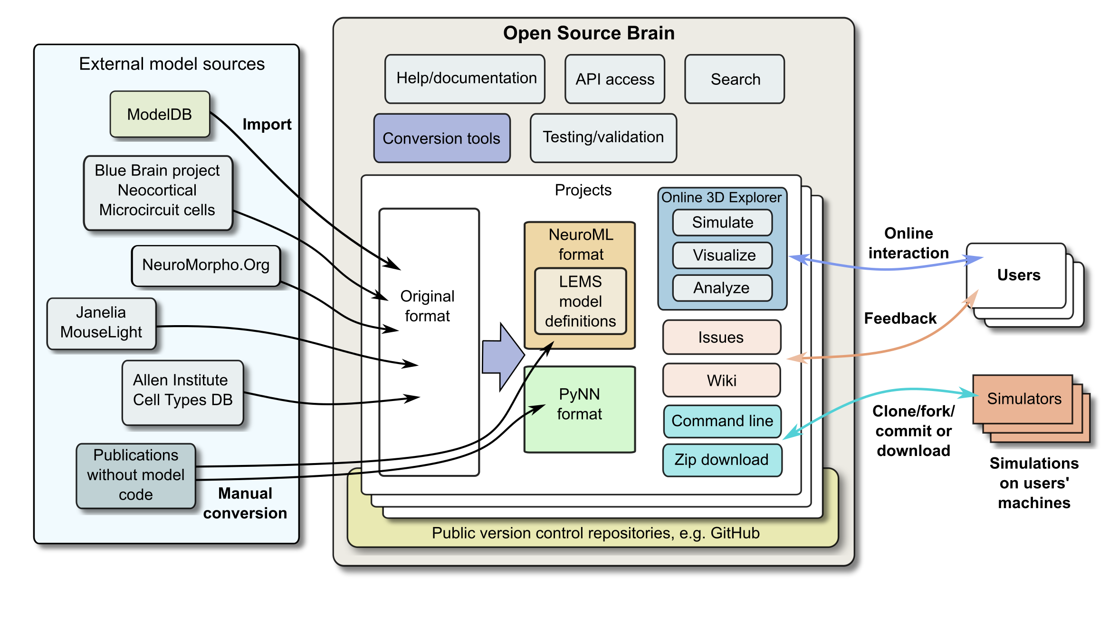
OSB features
Notes:
8/17/17
29
29

Slide 30
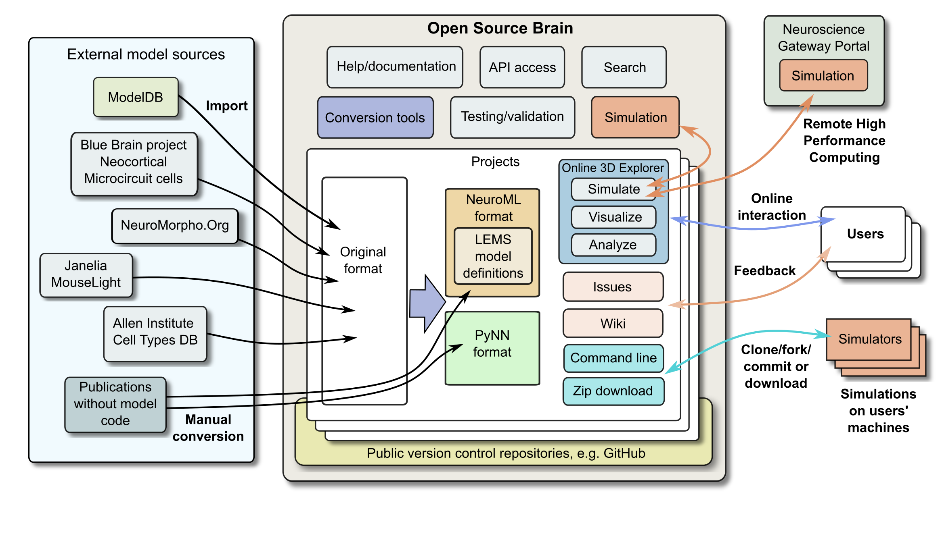
OSB features
Notes:
8/17/17
30
30

Slide 31
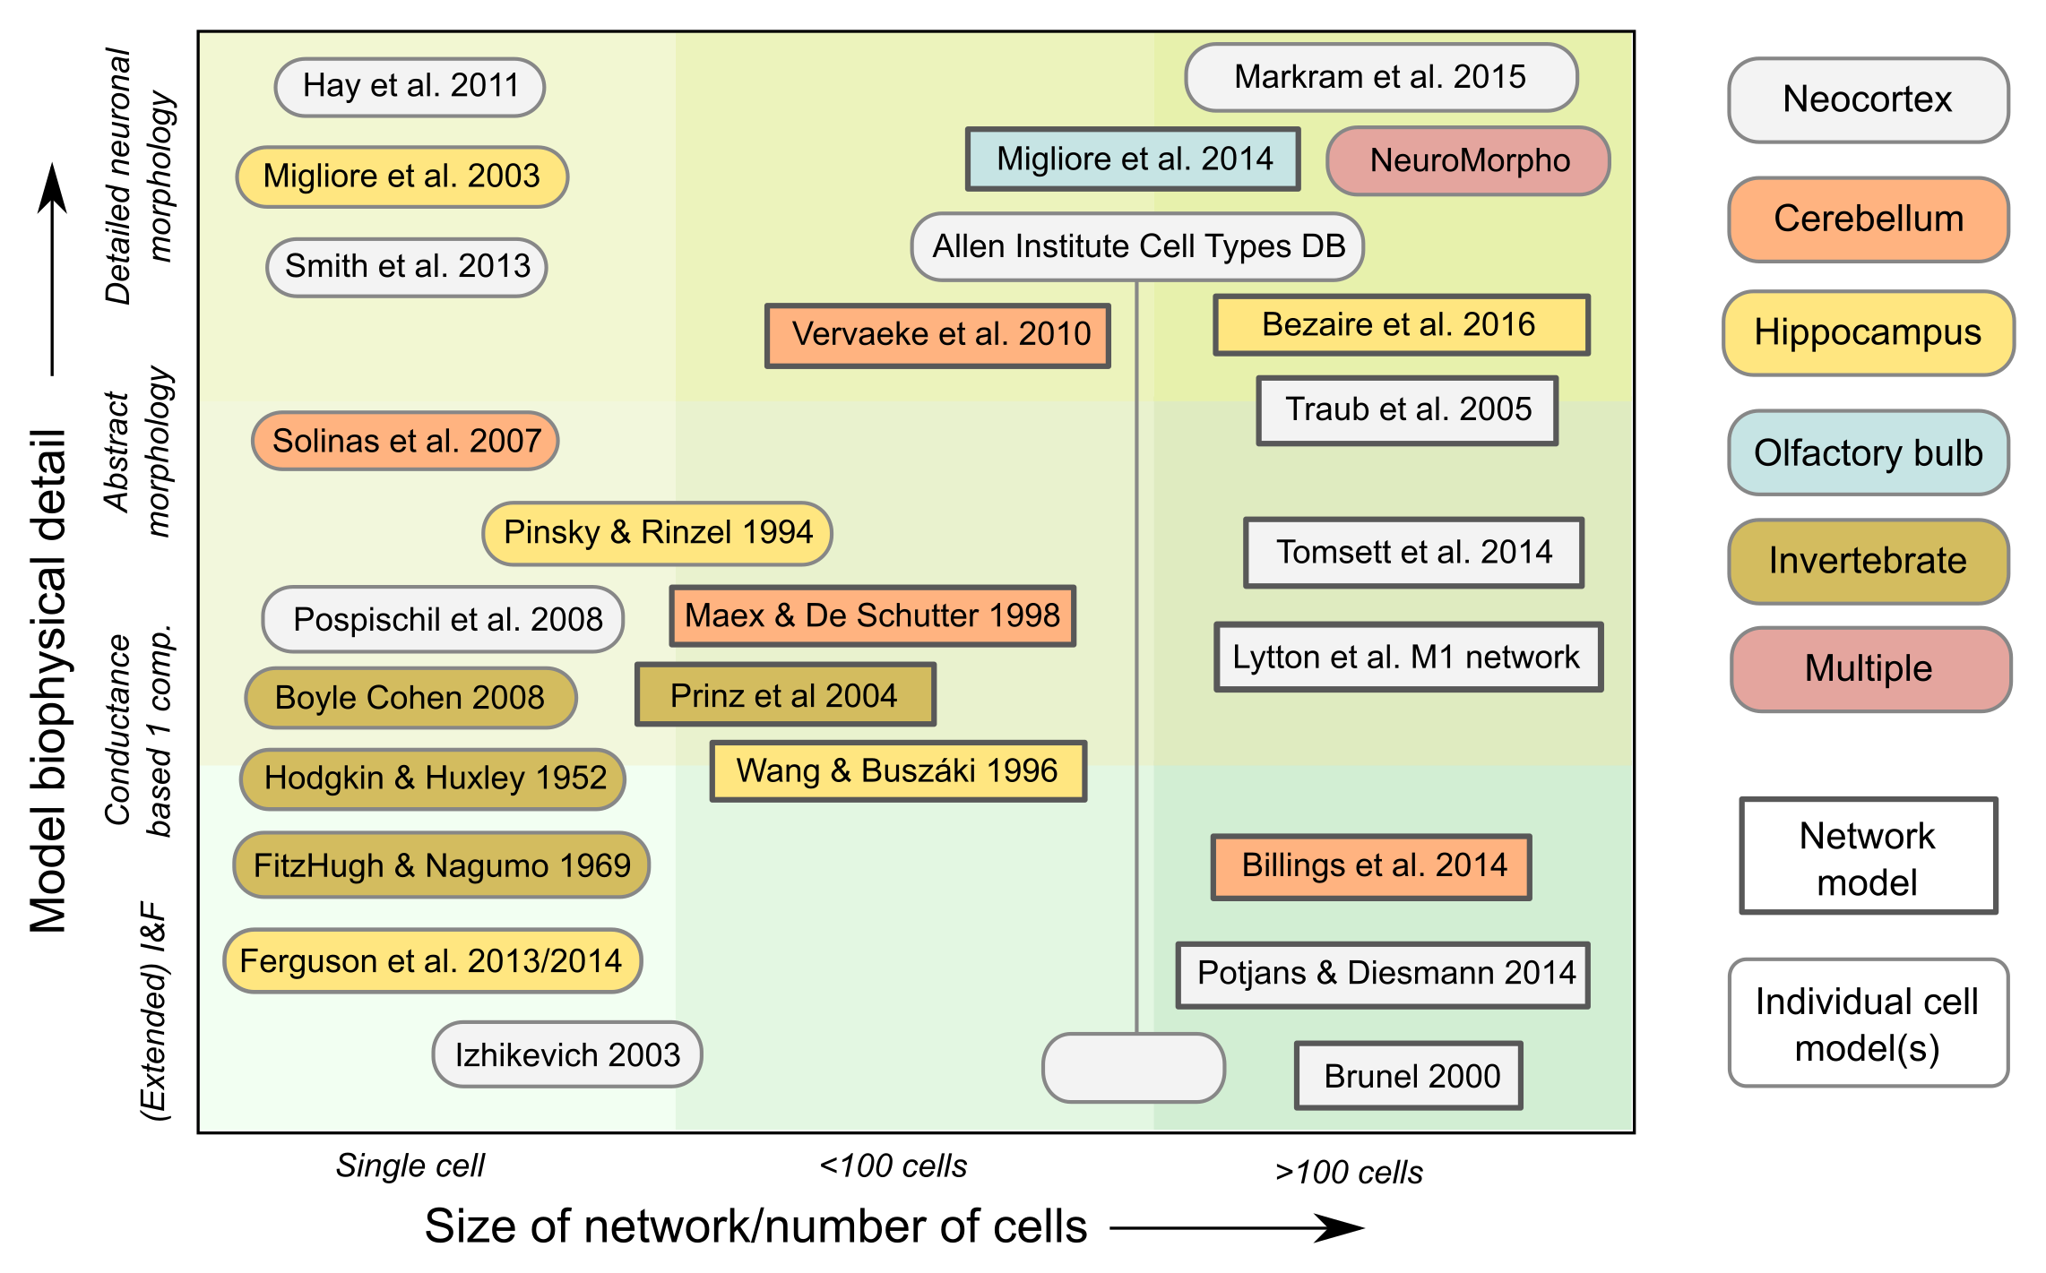
Notes:
8/17/17
31
31

Slide 32
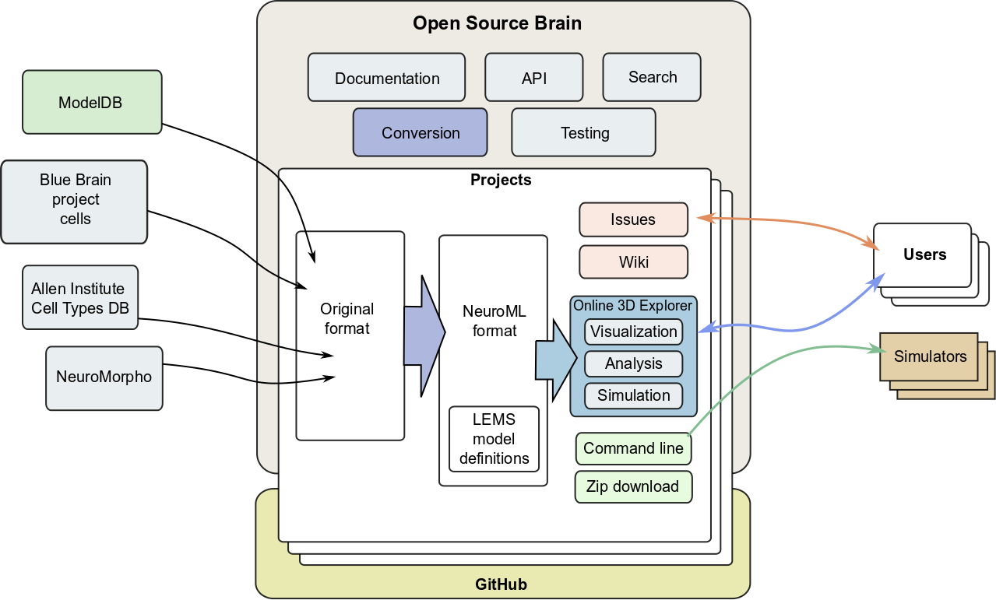
OSB features
Notes:
8/17/17
32
32

Slide 33
For public models in NeuroML OSB lets users...
Visualise
Analyse
Simulate
http://www.opensourcebrain.org
Notes:
8/17/17
33
33

Slide 34
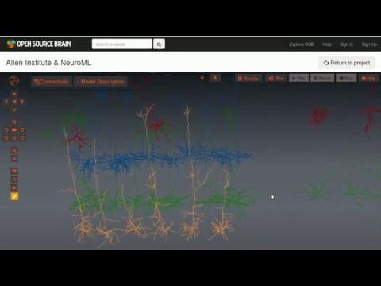

Slide 35
For public models in NeuroML OSB lets users...
Visualise
Analyse
Simulate
http://www.opensourcebrain.org
Notes:
8/17/17
35
35

Slide 36


Slide 37
For public models in NeuroML OSB lets users...
Visualise
Analyse
Simulate
http://www.opensourcebrain.org
Notes:
8/17/17
37
37

Slide 38
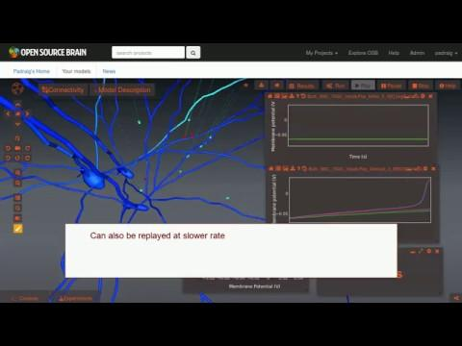

Slide 39
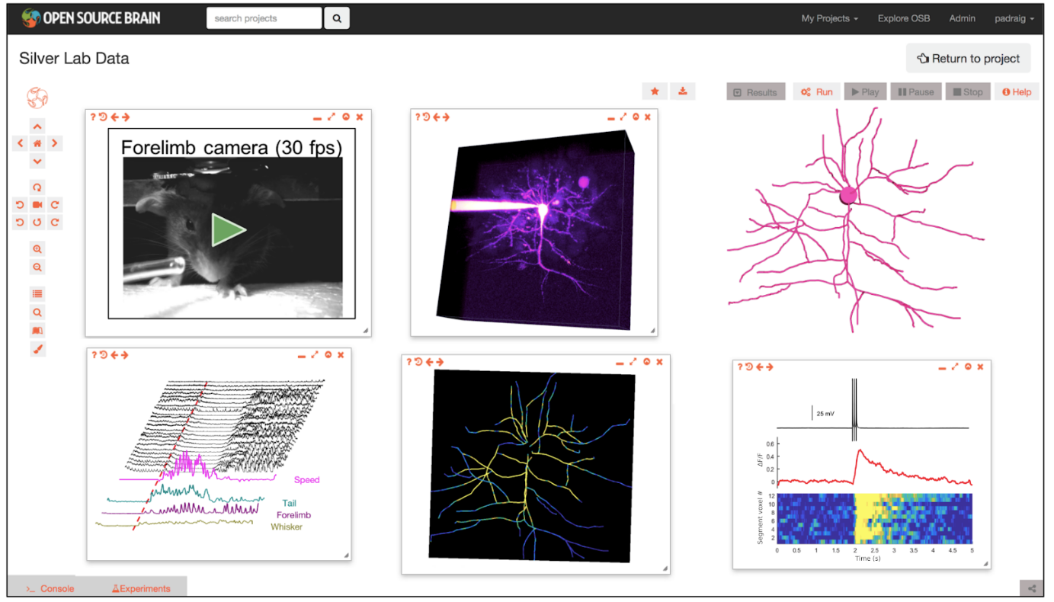
Open Source Brain v2.0
Notes:
8/17/17
39
39

Slide 40
Open Source Brain v2.0
Interaction with models
Build from scratch: NetPyNE
Interaction with experimental data
Neurodata Without Borders (NWB)
Jupyter Notebooks
Shareable Python workspaces
Notes:
8/17/17
40
40

Slide 41
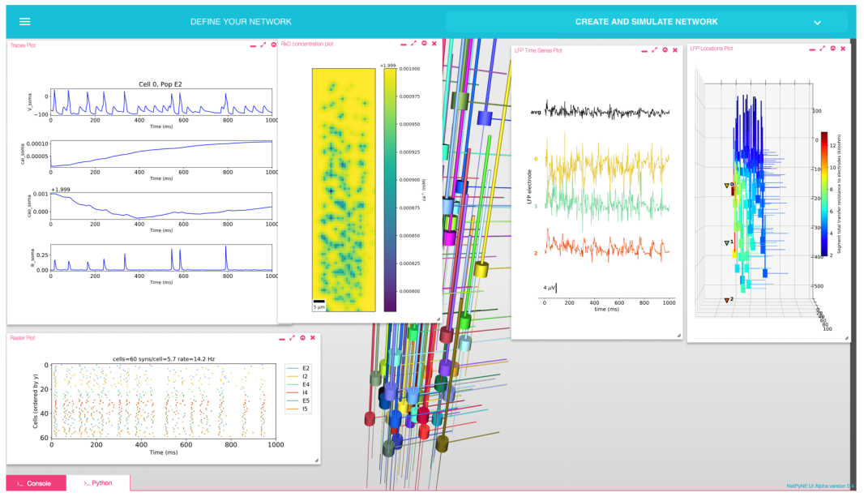
NetPyNE
Notes:
8/17/17
41
41

Slide 42
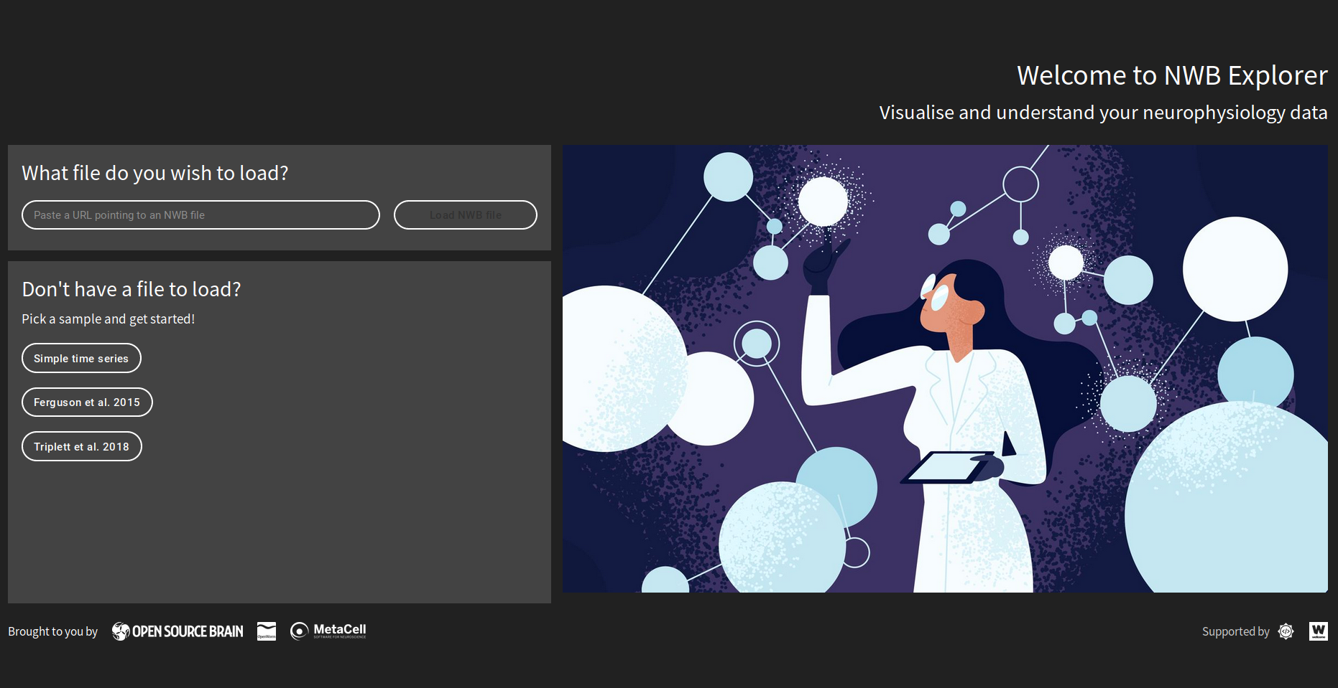
Neurodata Without Borders Explorer
Notes:
8/17/17
42
42

Slide 43
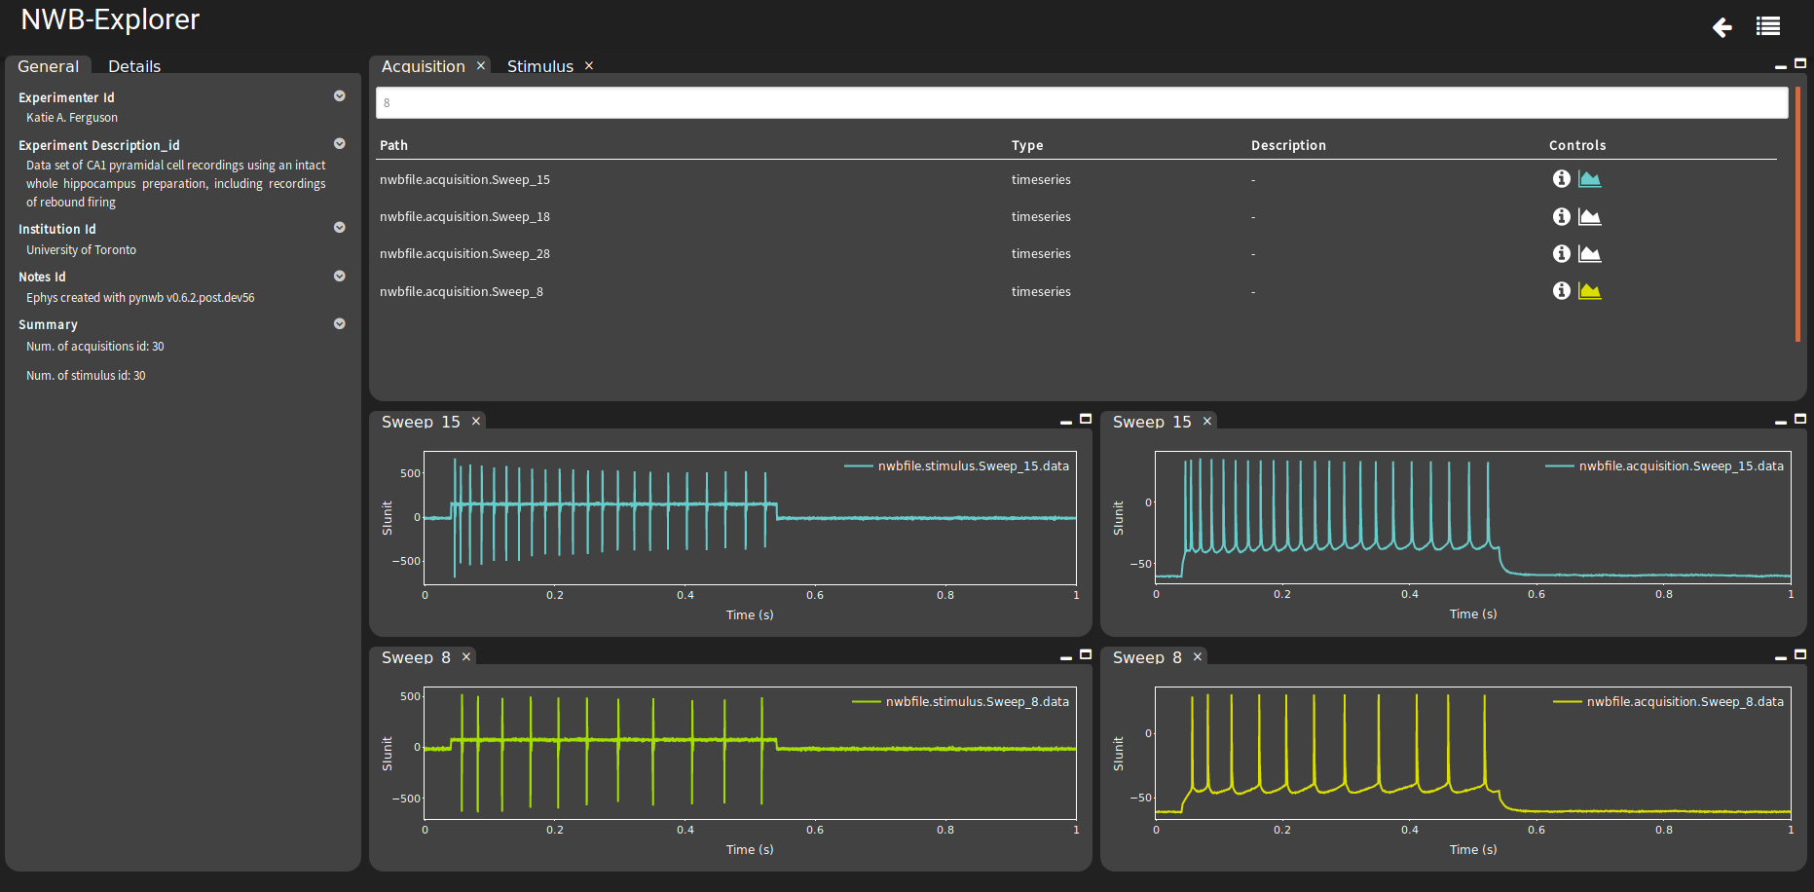
Neurodata Without Borders Explorer
Notes:
8/17/17
43
43

Slide 44

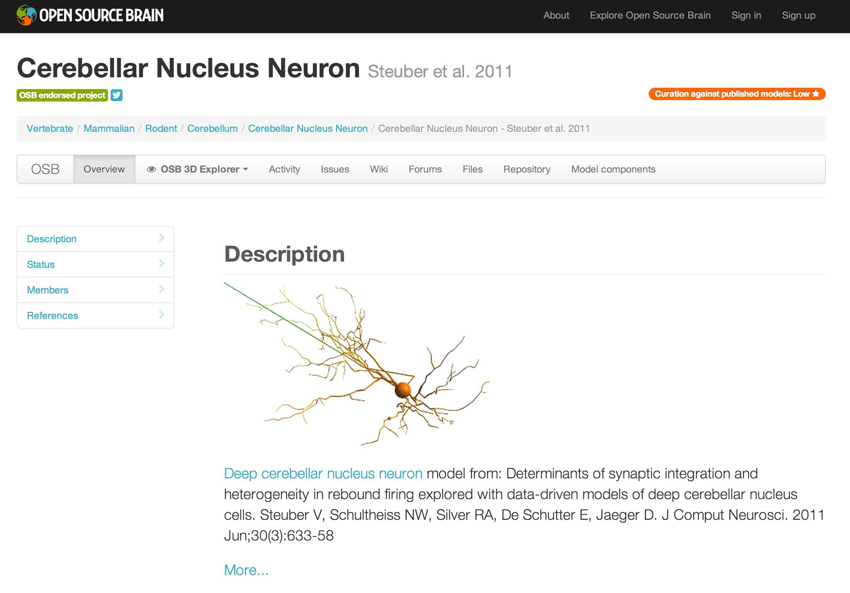
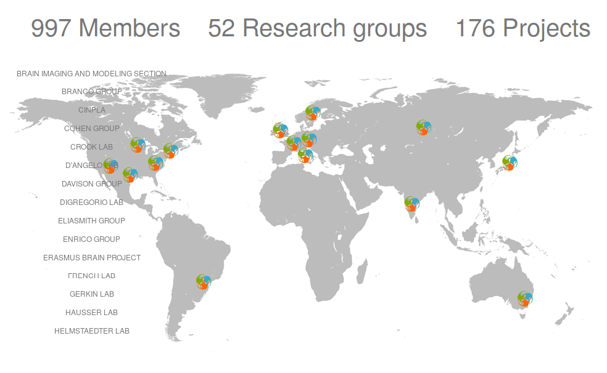
http://www.opensourcebrain.org
Notes:
8/17/17
44
44
44

Slide 45
International & collaborative aspects
NeuroML Editorial Board
Open Source Brain
COMBINE - SBML, CellML, SBGN, BioPax, SED-ML, SBOL
Notes:
8/17/17
45
45

Slide 46

International & collaborative aspects
NeuroML Editorial Board
Open Source Brain
COMBINE - SBML, CellML, SBGN, BioPax, SED-ML, SBOL
INCF Special Interest Group (SIG) on Standardised Representations of Network Structures
Contributors include: Allen Institute, Human Brain Project, NEST, The Virtual Brain, NetPyNE, PyNN
Notes:
8/17/17
46
46

Slide 47
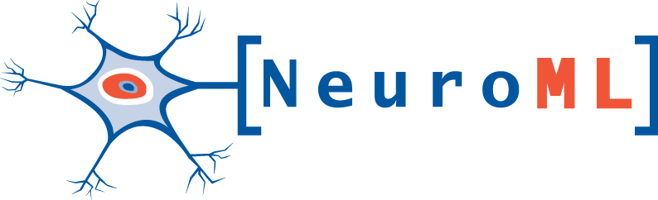







Acknowledgements
Silver Lab @ UCL
Angus Silver
Matt Earnshaw
Sadra Sadeh
Alex Cayco-Gajic
Eugenio Piasini
Boris Marin
Adrian Quintana
Matteo Farinella
Yates Buckley
Rokas Stanislovas
Andras Ecker
Matteo Cantarelli (MetaCell)
Collaborators
Robert Cannon
Sharon Crook
Jessica Dafflon
Sergio Solinas
Volker Steuber
Dieter Jaeger
Andrew Davison
Stephen Larson
Avrama Blackwell
Members of the NeuroML community
OpenWorm project MetaCell
Coordinating initiatives
Funding sources
Notes:
8/17/17
47
47

